Slide 1

FCFS

Slide 2

GROUP MEMBERS
Danish Abdullah
Mamoon Haseeb
Alina Khan
M. Munawar
Umair Ahmad
Arslan

Slide 3
INTRODUCTION
In the FCFS scheduling algorithm, the job that arrived first in the ready queue is allocated to the CPU and then the job that came second, and so on.
It follows the non-preemptive approach i.e. once a process has control over the CPU it will not preempt until it terminates.

Slide 4

OBJECTIVES
Simulating process execution using Pygame & Tk inter.
Visual representation of FCFS scheduling.

Slide 5

TOOLS & CONCEPTS
Programming Language: Python
Library: Tkinter
Core Concepts:
Object-Oriented Programming (OOP).
Visually representation
Run time simulation

Slide 6

PROJECT FEATURES
Visual representation
User Input
Table & Gantt Chart
Time Calculation

Slide 7
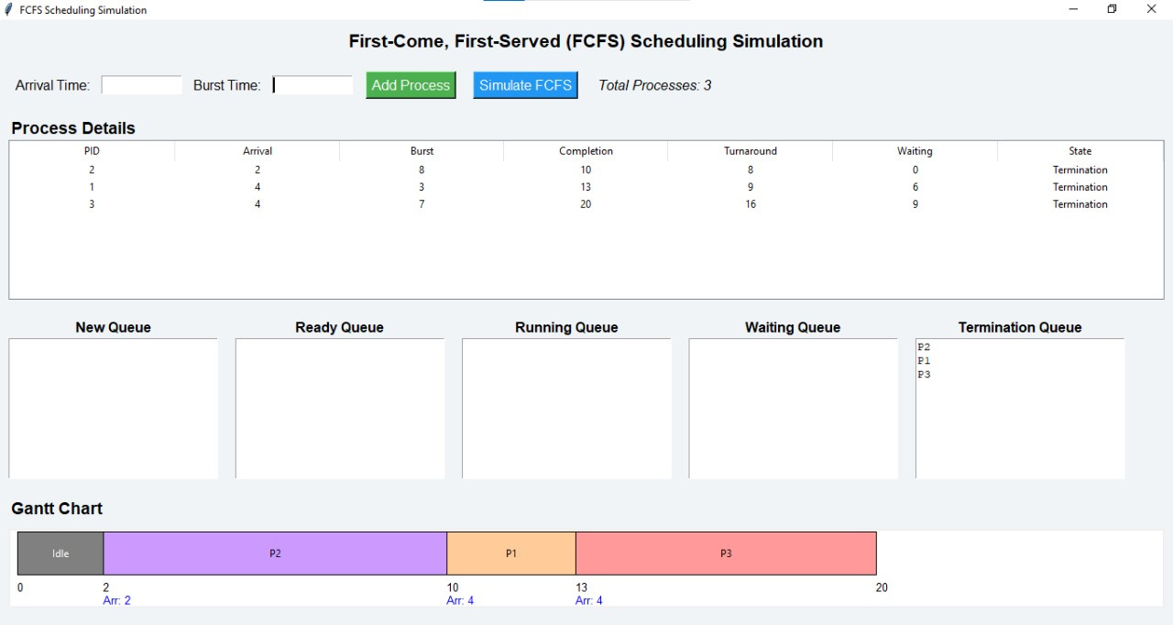
RESULT

Slide 8
TOOLS & CONCEPTS
Programming Language: Python
Library: Pygame
Core Concepts:
Object-Oriented Programming (OOP) for process handling.
Real-time animations.
Sound integration for user interaction.

Slide 9
PROJECT FEATURES
Visual representation of process execution order
Processes move dynamically to the CPU
Sounds for different process states
Enhances visual appeal for better understanding

Slide 10
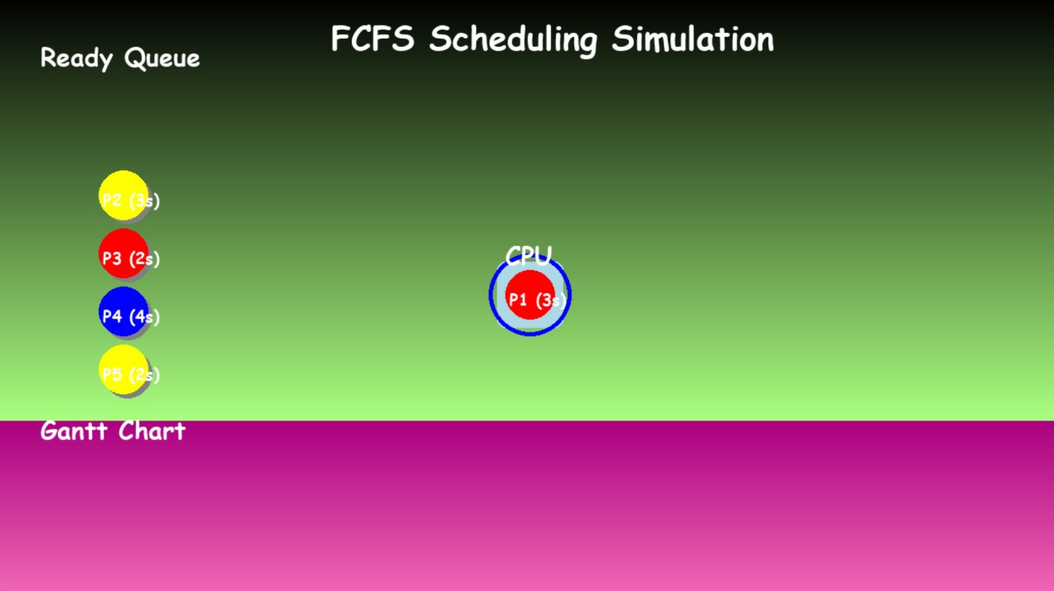
RESULT

Slide 11
THANK YOU

